Slide 1
Introduction to Coding
Instructors: Amanda Farah, Maria Hernandez, Katie Dixon
Teaching Assistants: Angela Wang, Alex Liu, Khalil Sayid,Justina Cho

Slide 2

Goals:
Students will be able to:
Understand coding basics like loops, datatypes, and operators
Comfortable with basic python libraries such as numpy, matplotlib, and pandas
Comfortable loading in, manipulating, and plotting 2D datasets
Comfortable approaching and learning new code

Slide 3
What is programming and why?
Programming is instructing your computer to do various tasks
Why learn to program?
Speed and energy
Computers are much faster and don’t need to sleep (generally)
Can automate tasks
Can connect to high performance computers to be even faster

Slide 4
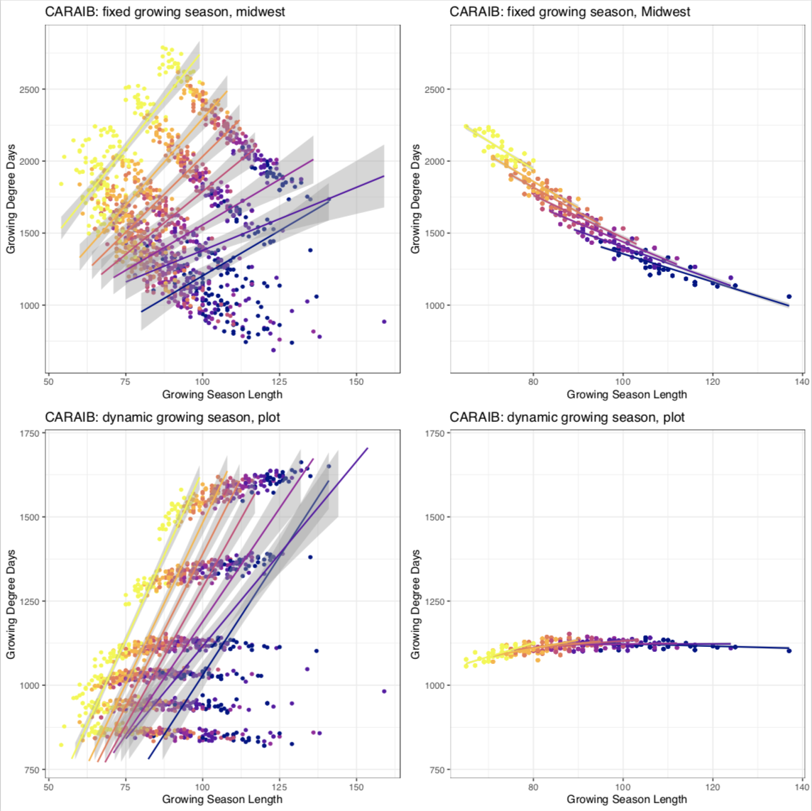
Visualize data
Visualizing yields in response to growing season length at different temperatures (color)
Each of the groupings of points is at a different location
Can see the direction of the response is different when you look at the whole midwest vs. one location

Slide 5
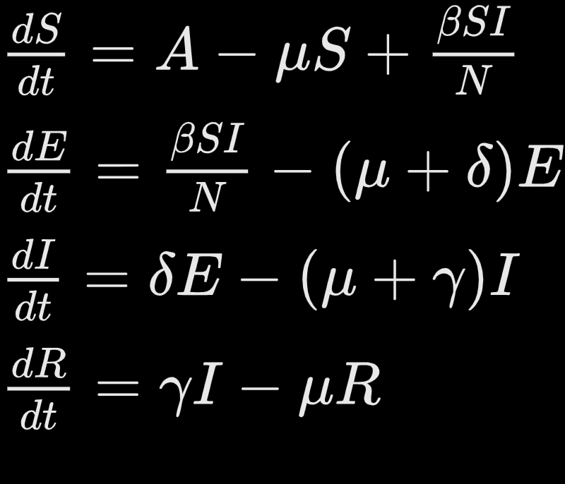
Computations you can’t/ don’t want to do by hand
Simulating a SEIR disease model with demography Impossible/ nearly impossible by hand Almost instantaneous with a ordinary differential equation (ODE) solver

Slide 6
Why Python?
General purpose, open source coding language
R is written for statistical computing and data analysis
The best data analysts keep in mind the strengths and weaknesses of different languages
Code can be translated between languages relatively easily
Once you pick up one, the time spent learning a new one goes down: ME

Slide 7
Different environments for Python
Integrated Development Environment (IDE)
Can help you debug
Can be hard to choose which one is the best one
The more I googled, the more I found
Jupyter notebooks, spyder, pycharm, google colab

Slide 8
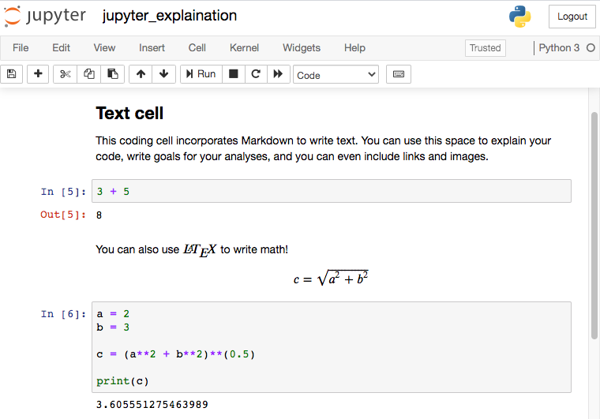
Jupyter Notebooks
Incorporates Markdown to write text
Can use other languages using a kernel (R, Julia, etc.)
Readable, reproducible interface

Slide 9

Google Colaboratory
Built off of jupyter and hosted on google
Built in libraries, don’t have to deal with dependencies
Saves automatically
Share and collaborate on your code easily
Can’t run programs for very long without shutting down
Need internet connection

Slide 10
Resources
Although we tried, we can’t cover everything
Expert coders are still learning something new all the time
Error messages: sometimes helpful! Read them and learn from the mistakes
Expert coders make errors all the time
I still make the same mistakes as I did 8 years ago
There is a reference sheet with a basic outline of what was covered each day, designed to be used while you go through the lessons and after you complete this course. You will find more information in Day 1.

